Slide 1
Comparison of various Anomaly detection algorithms & Techniques
BY PRAKHAR DOGRA
G01009586

Slide 2
Main goal
This project aims to apply different algorithms & techniques on Credit Card Fraud data set and compare the results.
Measures used to compare those are Area Under the Curve, False (Alarm) Positive Rate and Recall (Detection Rate).
Measure like Accuracy is not good because the data set is highly unbalanced.

Slide 3
Dataset
The datasets contains transactions made by credit cards. This dataset presents transactions that occurred in two days, where we have 492 frauds out of 284,807 transactions. The dataset is highly unbalanced, the positive class (frauds) account for 0.172% of all transactions.
Due to confidentiality reasons, dataset available is not the original (raw) form but actually has been reduced using PCA. And the only features which have not been transformed with PCA are 'Time' and 'Amount'.
WEBLINK: https://www.kaggle.com/dalpozz/creditcardfraud

Slide 4
TYPES OF ANOMALY DETECTION TECHNIQUES USED
Classifier Based – One Class SVM, Random Forest Classifier, Isolation Forest
Nearest Neighbour Based – Using KNN and Local Outlier Factor
Statistical Based – Mahalonobis distance method and Log Likelihood method
Transduction Based – Using KNN and LOF as strangeness function
Graph Based – Convex Hull Method
Manipulating Data Records – Undersampling, Oversampling and SMOTE

Slide 5
Classification based
Can be supervised as well as unsupervised
But since number of anomaly class in test set is unbounded and training might lead to overfitting
General classification methods:
One Class SVM
Neural Networks Based – Auto Encoders
Bayesian Network Approaches
Decision Tree Based Techniques – Random Forest Classifier and Isolation Forest

Slide 6

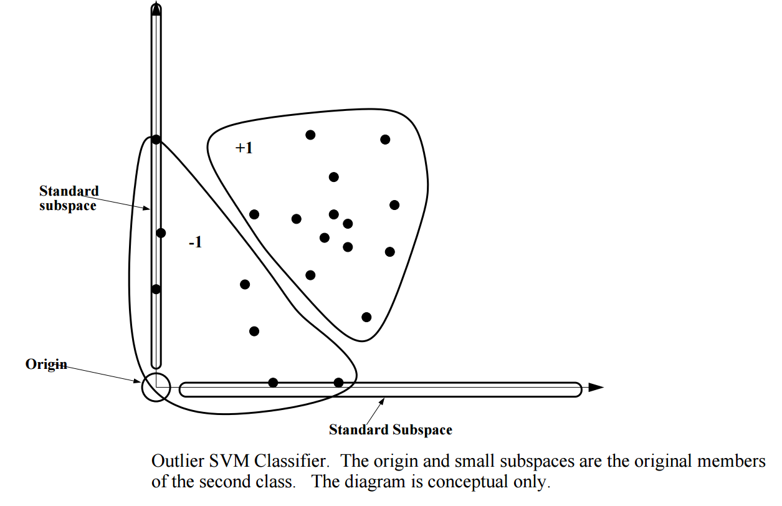
One Class svm

Slide 7
One Class svm
Separate the entire set of training data from the origin, i.e. to find a small region where most of the data lies and label data points in this region as one class.
AUC: 0.94 FPR: 0.04
Recall: 0.917

Slide 8
Isolation forest
This algorithm is based on the fact that anomalies are data points that are few and different. As a result of these properties, anomalies are susceptible to a mechanism called isolation.
AUC: 0.913 FPR: 0.097 Recall: 0.923

Slide 9
Nearest neighbour based
Two-step approach:
Compute neighborhood for each data record
Analyze the neighborhood to determine whether data record is anomaly or not.
Various Methods are:
Distance Based – KNN algorithm
Density Based – LOF, COF, LOCI, etc.

Slide 10
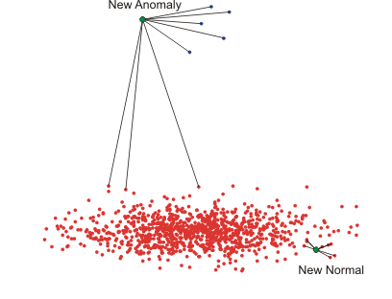
K nearest neighbour

Slide 11
K NEAREST NEIGHBOUR TECHNIQUE
For each data point, compute the distance to the K^{th} nearest neighbor.
Sort all data points according to the calculated distance.
Outliers are points that have the largest calculated distance and therefore are located in the more sparse neighborhoods.
AUC: 0.894 FPR: 0.02 Recall: 0.808

Slide 12
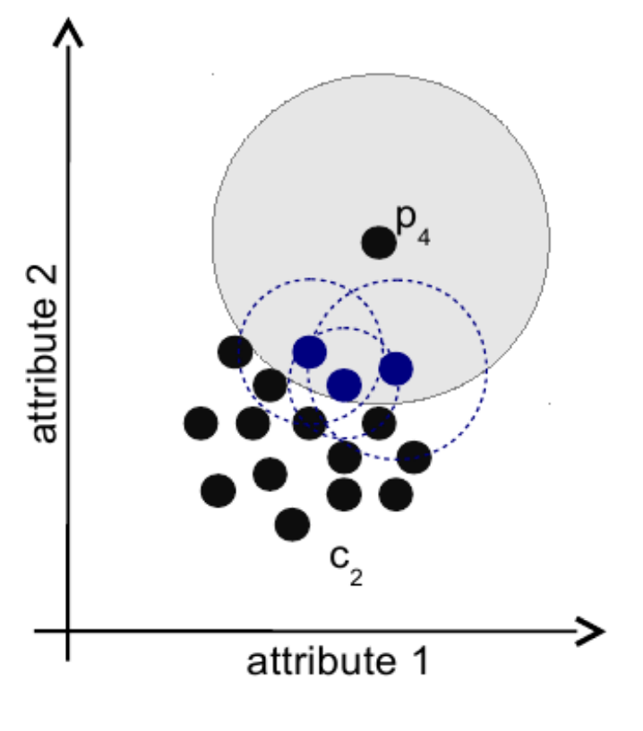
Local outlier factor

Slide 13
Local outlier factor method
Find the k-nearest-neighbors
For each instance, compute the local density
For each instance compute the ratio of local densities
Normal examples have scores close to 1.0
Anomalies have scores > (1.2 ... 2.0)
AUC: 0.911 FPR: 0.082 Recall: 0.904

Slide 14
Statistical Based
Data points are modeled using stochastic distribution and points are determined to be outliers depending on their relationship with this model.
Various techniques can be used:
Mahalonobis distance from the centroid can be used to find outliers
Log Likelihood measure can also be used by checking log likelihood of the dataset for every data point.

Slide 15
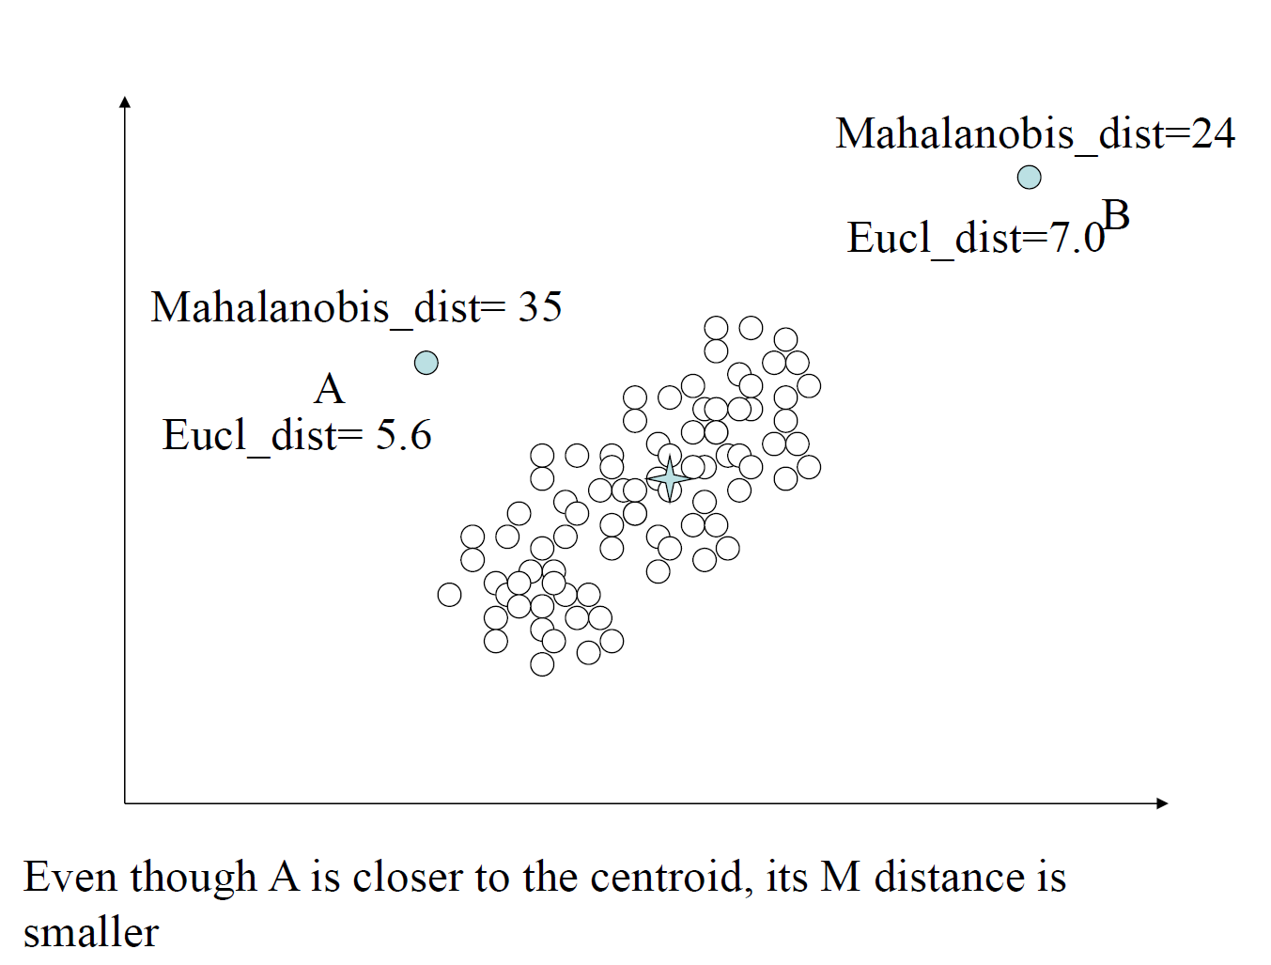
Mahalanobis distance method

Slide 16
Mahalanobis distance method
Find the Squared Mahanalobis Distance of each point:
Mahalanobis(x, x’) = (x-x’)S⁻¹(x-x’)^{T} where x’ is mean and S is covariance
AUC: 0.915 FPR: 0.036 Recall: 0.865

Slide 17
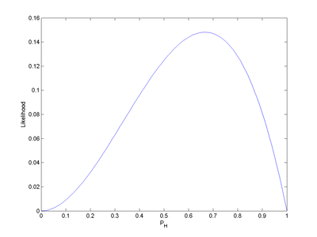
Likelihood approach

Slide 18
Log likelihood based method
Let M be the set of normal data points and A be the set of anomalous points.
Initially assume all points to be in M (A is empty) and find Loglikelihood of M.
Remove a point from M and find the new Loglikelihood of M.
If the Loglikelihood changes significantly (change in likelihood is grater than some threshold) then move it to A
Otherwise keep it in M
AUC: 0.916 FPR: 0.036 Recall: 0.865

Slide 19
Transduction based
Transduction is the procedure that reasons from specific cases (training) to specific cases (test)
A strangeness function measures how strange an item is.
Given a distribution of strangeness values for the general population, compute the likelihood of being an outlier for a given point.
It avoids creating a model by making only decisions about individual points at a time.

Slide 20
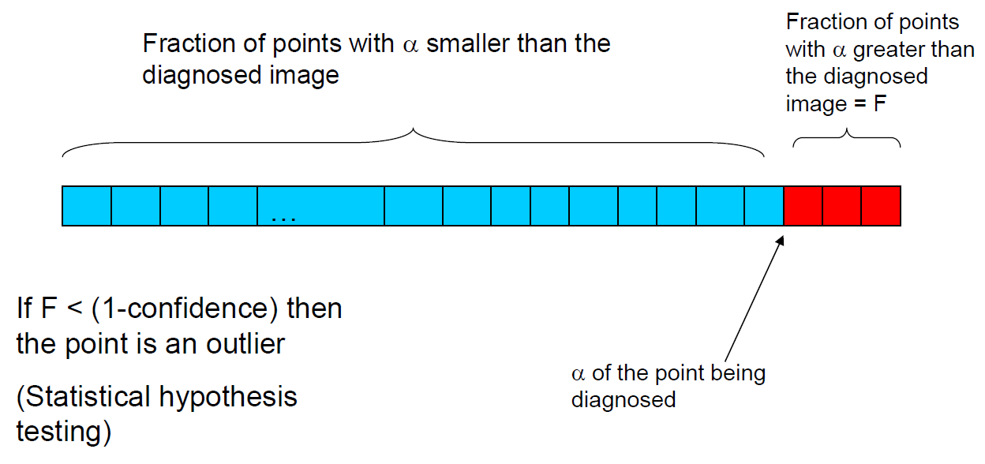
StrOUD ALGORITHM

Slide 21
STROUD ALGORITHM
Sample the data set. Make sure only normal data points are selected.
Calculate strangeness value of each point. This is called the baseline.
Sort the baseline (strangeness).
For each test point, compute strangeness value with respect to previous data points.

Slide 22
STROUD ALGORITHM
Find how many of those previous points had strangeness more than or equal to the calculated strangeness of the test point. Let’s call it b.
Compute p-value = (b+1)/(N+1) where N is the number of previous data points.
If p-value < (1-confidence) then the test point is an outlier otherwise it is not.

Slide 23
Knn as strangeness function
Strangeness value is calculated by first finding out the distances to K nearest neighbour of each point and then adding them up.
AUC: 0.896 at 95.5% confidence
FPR: 0.017 Recall: 0.808

Slide 24
Local outlier factor as strangeness function
Strangeness value is calculated by finding out the Local Outlier Factor of each point.
AUC: 0.89 at 97.5% confidence
FPR: 0.016 Recall: 0.854

Slide 25
Graph Based
Use visualization tools to observe the data.
Provide alternate views of data for manual inspection.
Anomalies can be detected visually.
Various methods can be:
Plotting graphs (Box plots/2D-plots/3D-plots)
Convex Hull

Slide 26
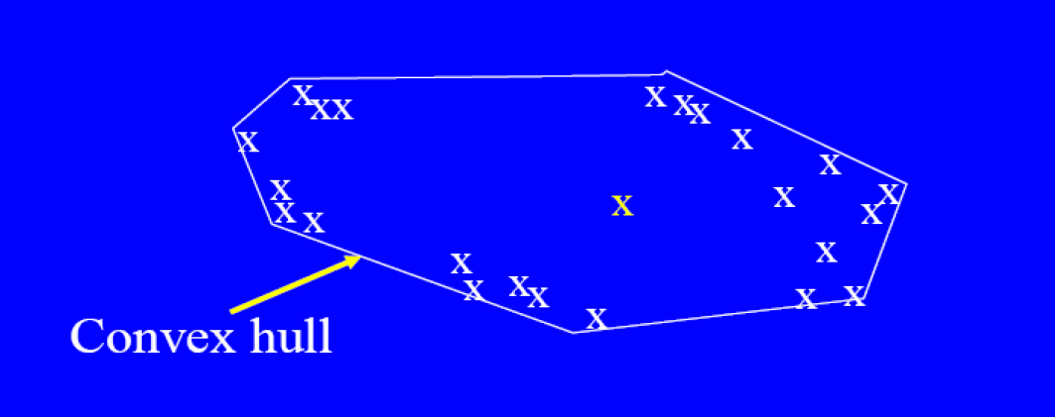
Convex Hull method

Slide 27
Convex Hull method
In this method, extreme points are assumed to be outliers. Basically the vertices of a Convex Hull can be the outliers.
AUC: 0.85 FPR: 0.041 Recall: 0.783

Slide 28
RESAMPLING THE DATA
Undersampling is basically downsizing (sampling) the majority class (normal class).
Oversampling is basically making duplicates of the rare class (anomalous class) examples.
SMOTE is basically used to generate artificial anomalies (not duplicates).

Slide 29
UNDERSAMPLING
Algorithms | Accuracy | AUC | FPR | Recall
J48 Decision Tree | 91.87 | 0.925 | 0.081 | 0.919
KNN (K=11) | 92.68 | 0.965 | 0.073 | 0.927
SVM | 93.19 | 0.932 | 0.068 | 0.932
Neural Networks | 91.565 | 0.959 | 0.084 | 0.916
Naïve Bayes | 91.26 | 0.957 | 0.087 | 0.913

Slide 30
OVERSAMPLING
Algorithms | Accuracy | AUC | FPR | Recall
J48 Decision Tree | 99.93 | 0.999 | 0.001 | 0.999
KNN (K=1) | 99.997 | 1.000 | 0.000 | 1.000
SVM | 99.95 | 0.999 | 0.001 | 0.999
Neural Networks | 97.98 | 0.993 | 0.020 | 0.980
Naïve Bayes | 91.37 | 0.977 | 0.086 | 0.914

Slide 31
SMOTE
Algorithms | Accuracy | AUC | FPR | Recall
J48 Decision Tree | 99.82 | 0.998 | 0.002 | 0.998
KNN (K=1) | 99.93 | 0.999 | 0.001 | 0.999
SVM | 99.64 | 0.996 | 0.004 | 0.996
Neural Networks | 99.13 | 0.999 | 0.009 | 0.991
Naïve Bayes | 90.89 | 0.981 | 0.091 | 0.909

Slide 32
COnclusion
Algorithms | AUC | FPR | Recall
One Class SVM | 0.89 | 0.027 | 0.81
Local Outlier Factor | 0.911 | 0.082 | 0.904
Log Likelihood | 0.916 | 0.036 | 0.865
StrOUD Algorithm | 0.896 | 0.016 | 0.854
Convex Hull | 0.85 | 0.041 | 0.783
Isolation Forest | 0.913 | 0.097 | 0.923

Slide 33
Future work
Compare more algorithms and techniques on this data set. Like Clustering based, Contextual Based and Information Theory Based Anomaly Detection algorithms and techniques.
Test these algorithms on more card fraudulent data sets.
If possible, make the implementations more efficient.

Slide 34
Thank you
Any Questions?

